Slide 1
Statistics of Chandrapur District

Slide 2
Data
We collected modelled data from the year 1948-2019.
Total number of days in the series are 26298.
We chose 4 variables: Rainfall, Soil Moisture,Relative Humidity and Surface Temperature.
Currently we try to model the data for a single district and expand it in coming days.

Slide 3
Rainfall
The collected 26298 values are divided into each year and average of each month for each year is calculated.
We even divided the data into seasonal months and non-seasonal months.
And the Annual precipitation for each year.

Slide 4
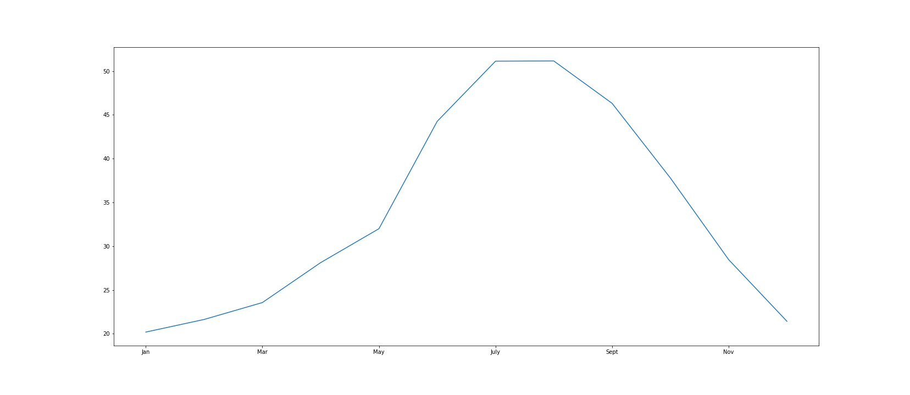
Monthly mean of Rainfall:

Slide 5
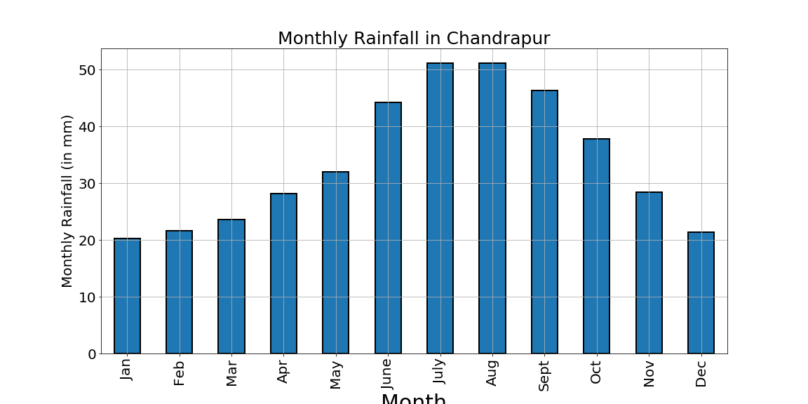
Monthly mean Barplot

Slide 6
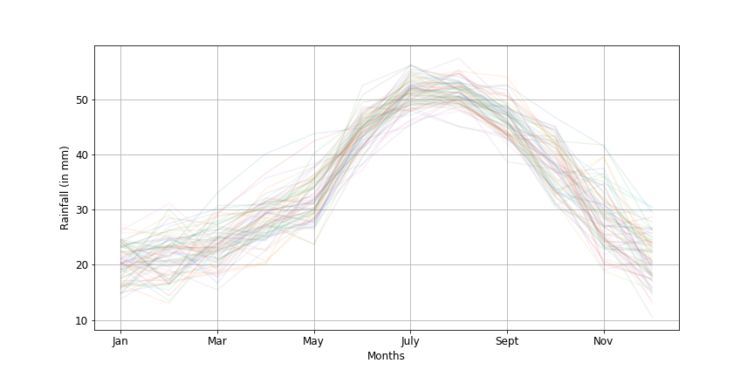
Monthly Variation:

Slide 7
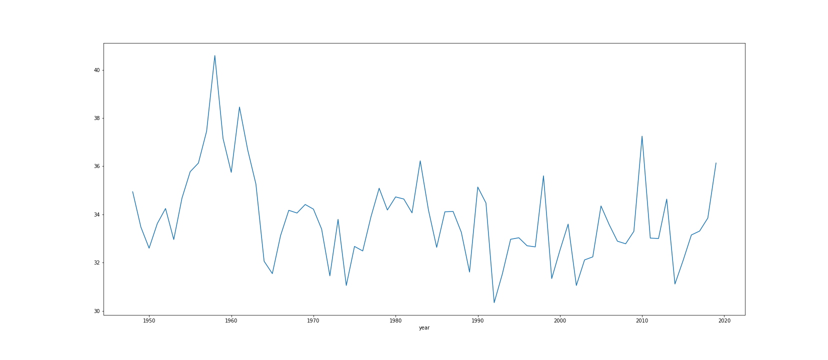
Yearly Mean of Rainfall:

Slide 8
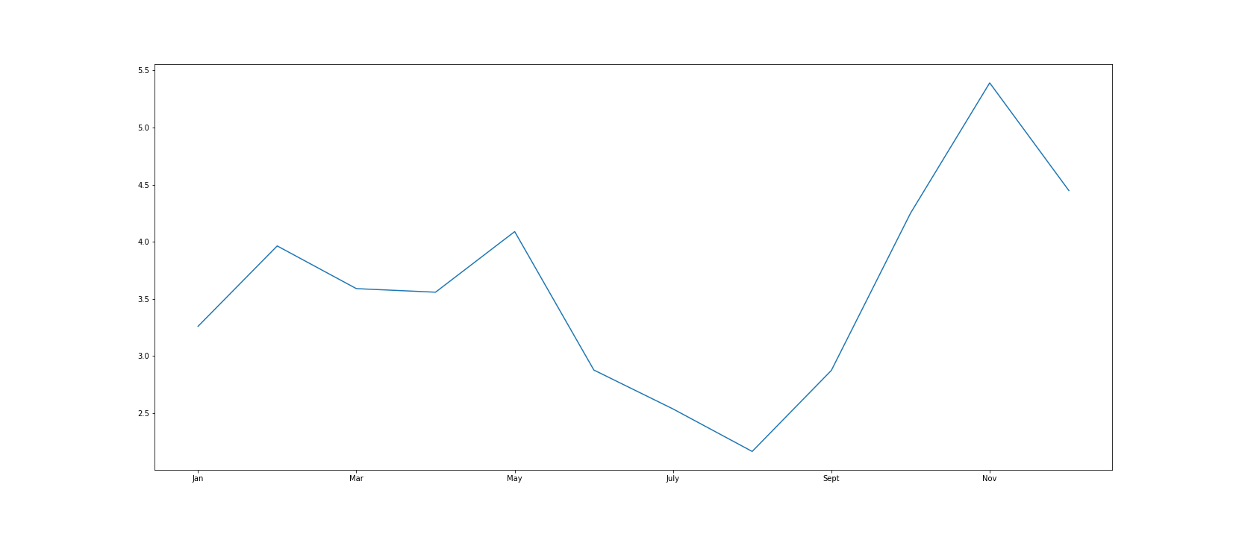
Monthly Standard Deviation:

Slide 9
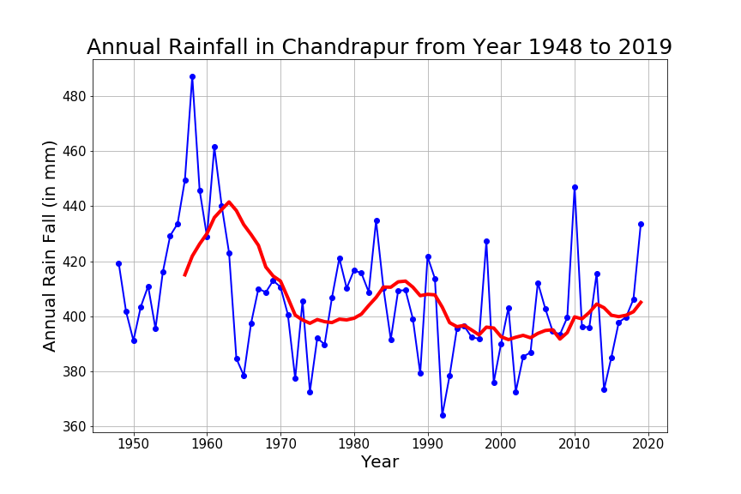
Annual Rainfall and Rolling Mean:

Slide 10
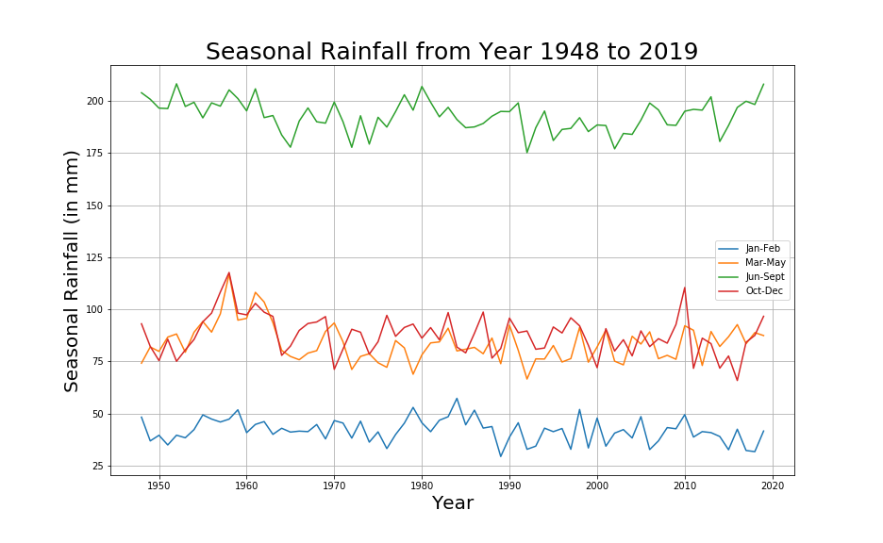
Seasonally Varying Rainfall:

Slide 11
Relative Humidity:
The collected 26298 values are divided into each year and average of each month for each year is calculated.
We even divided the data into seasonal months and non-seasonal months.
And the Annual precipitation for each year.

Slide 12
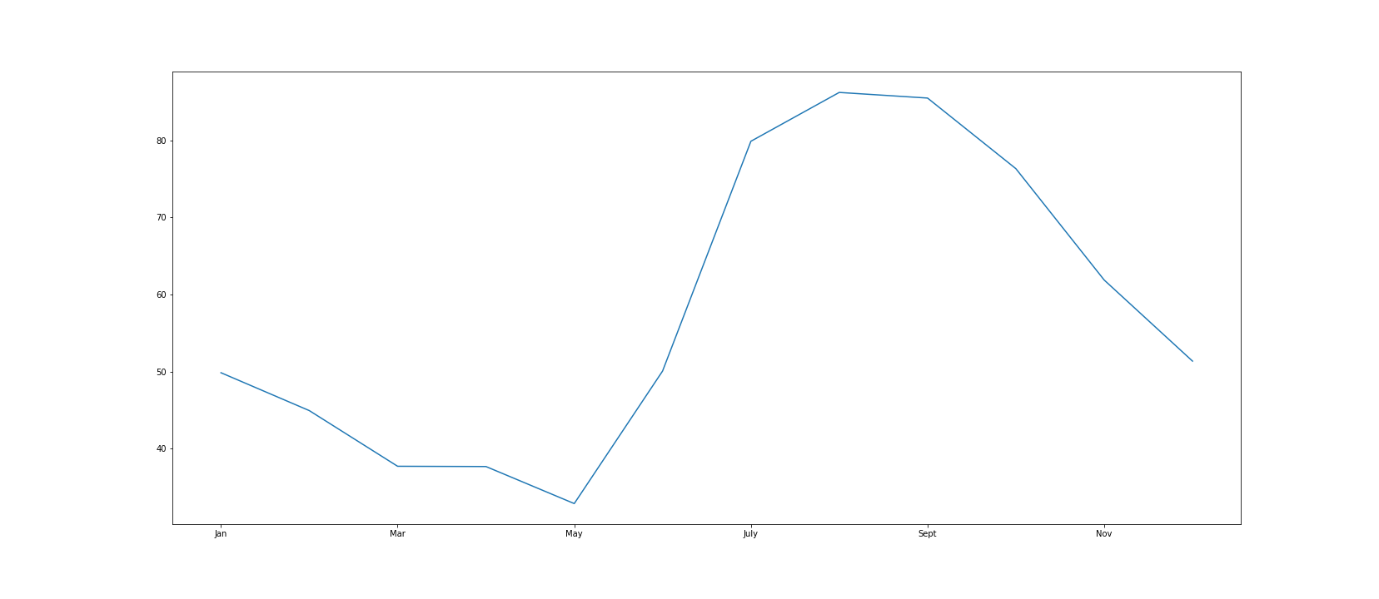
Monthly mean of Relative Humidity:

Slide 13
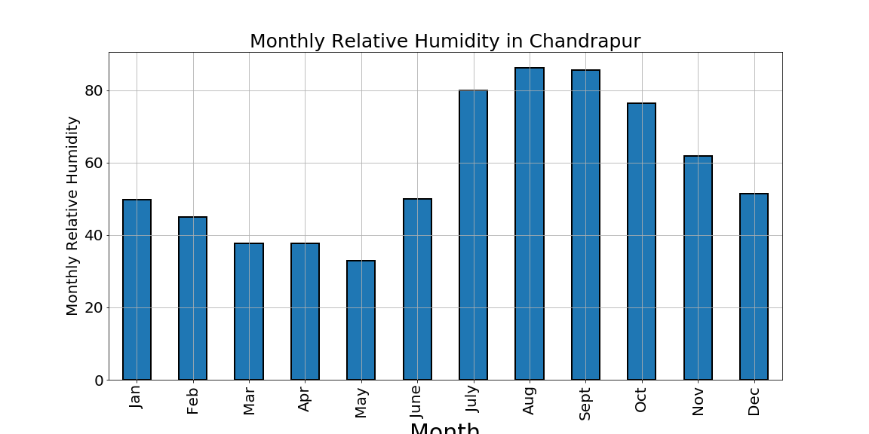
Monthly mean Barplot

Slide 14
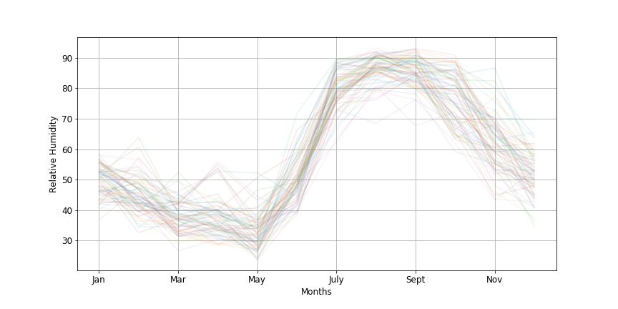
Monthly Variation:

Slide 15
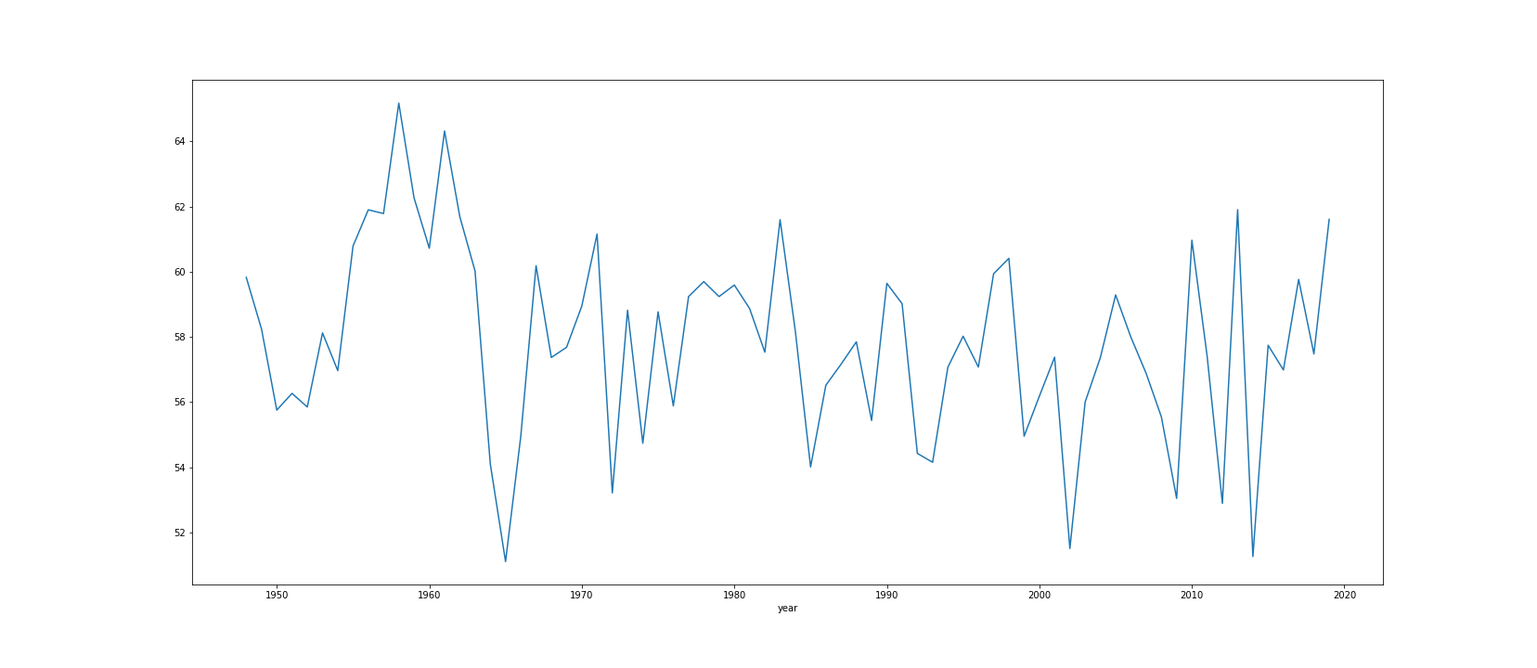
Yearly Mean of Relative Humidity:

Slide 16
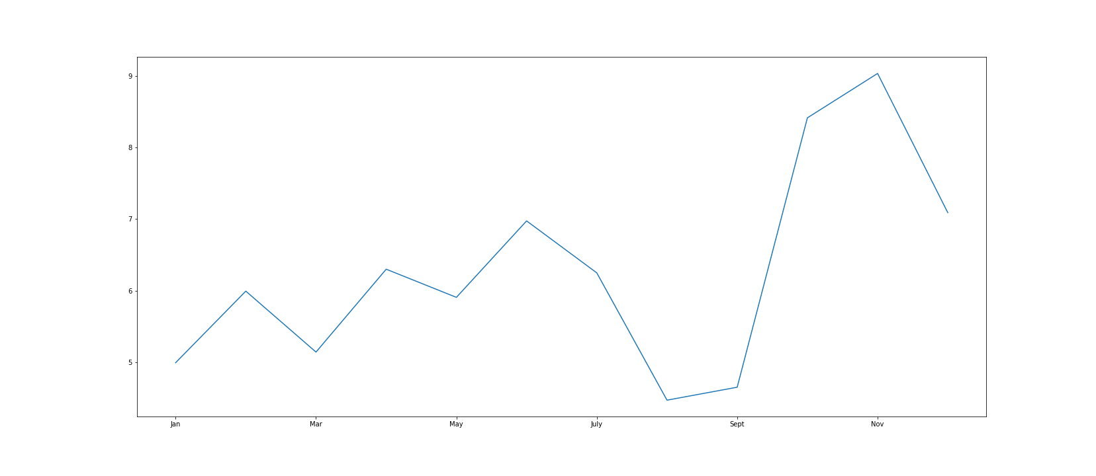
Monthly Standard Deviation:

Slide 17
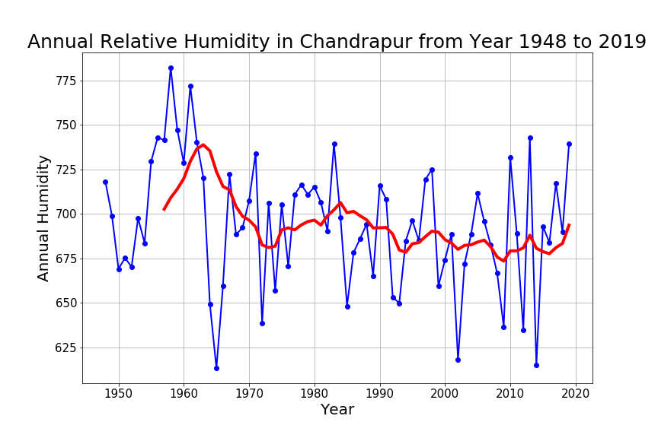
Annual Relative Humidity and Rolling Mean:

Slide 18
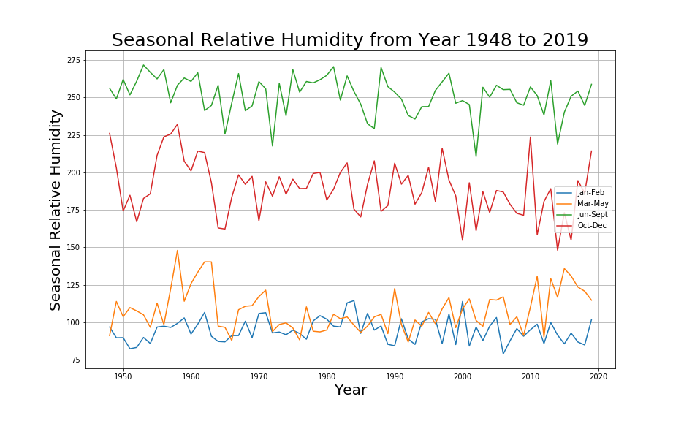
Seasonally Varying Relative Humidity:

Slide 19
Soil Moisture:
The collected 26298 values are divided into each year and average of each month for each year is calculated.
We even divided the data into seasonal months and non-seasonal months.
And the Annual precipitation for each year.

Slide 20
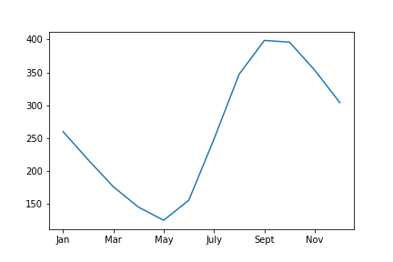
Monthly mean of Soil Moisture:

Slide 21
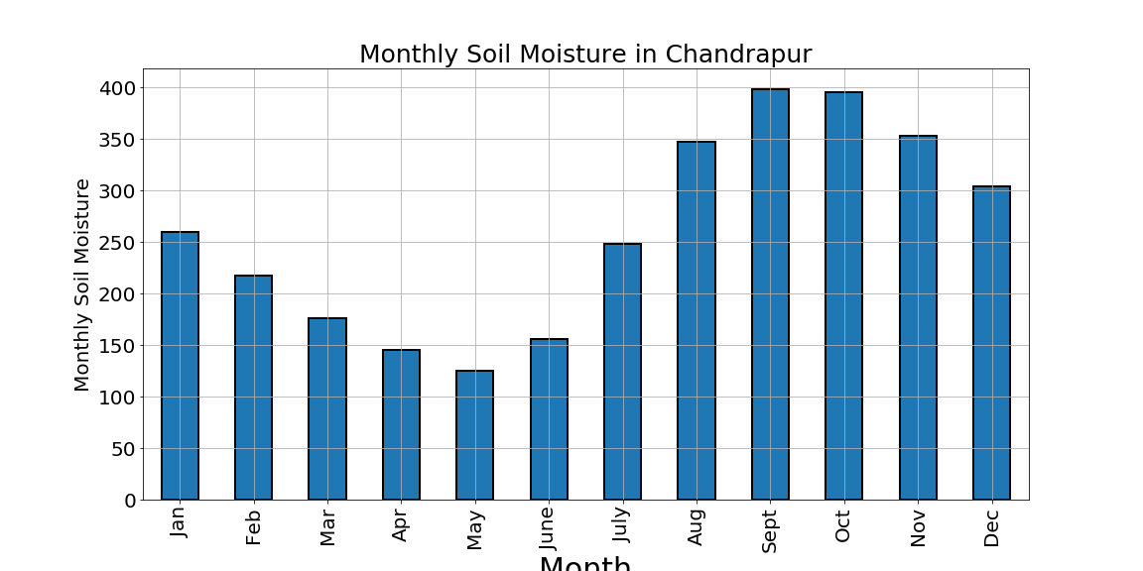
Monthly mean Barplot

Slide 22
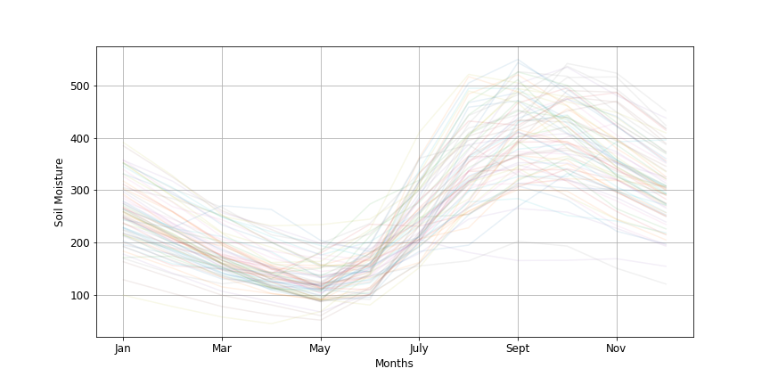
Monthly Variation:

Slide 23
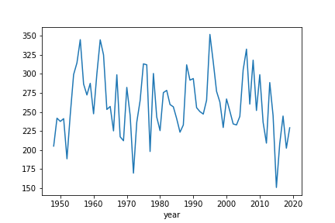
Yearly Mean of Rainfall:

Slide 24
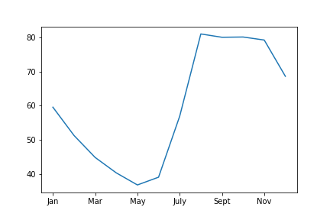
Monthly Standard Deviation:

Slide 25
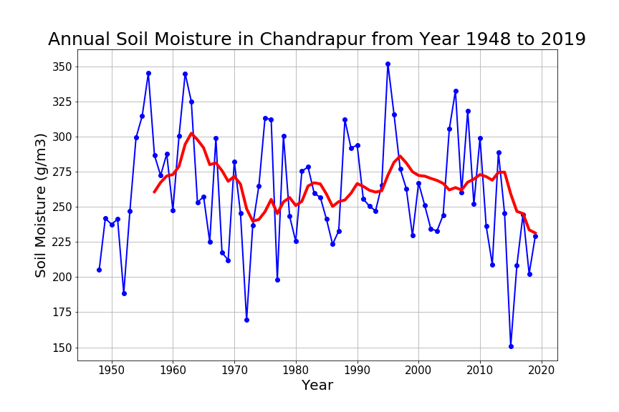
Annual Soil Moisture and Rolling Mean:

Slide 26
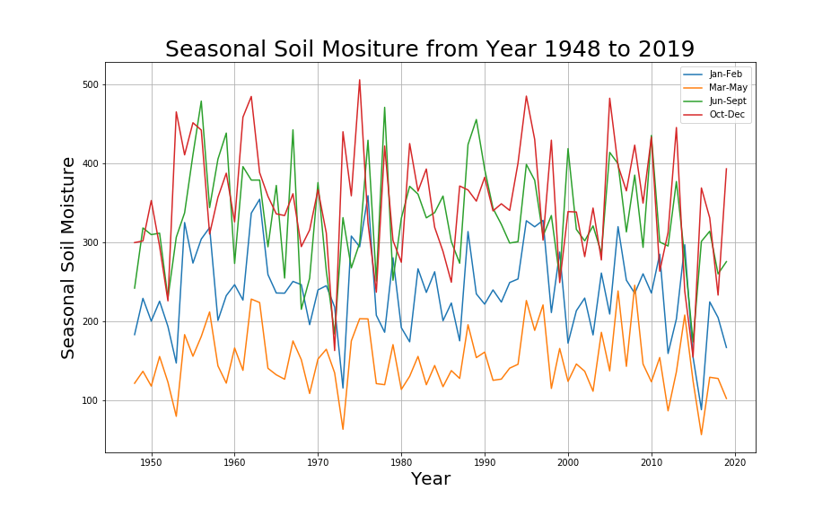
Seasonally Varying Soil Moisture:

Slide 27
Surface Temperature:
The collected 26298 values are divided into each year and average of each month for each year is calculated.
We even divided the data into seasonal months and non-seasonal months.
And the Annual precipitation for each year.

Slide 28
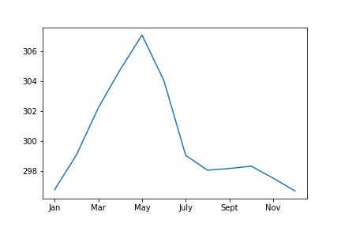
Monthly mean of Surface Temperature:

Slide 29
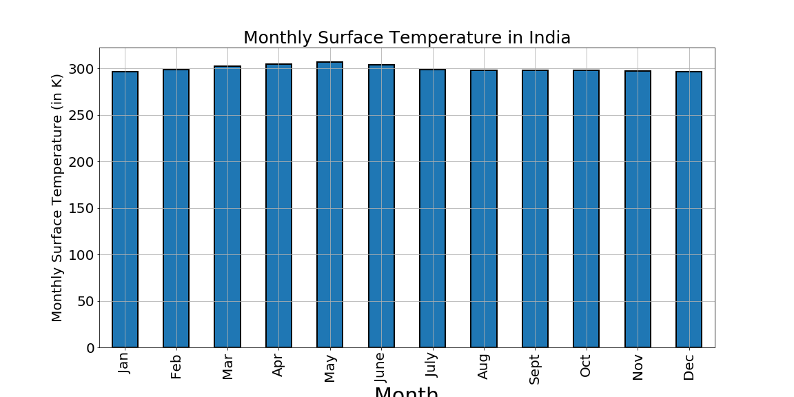
Monthly mean Barplot

Slide 30
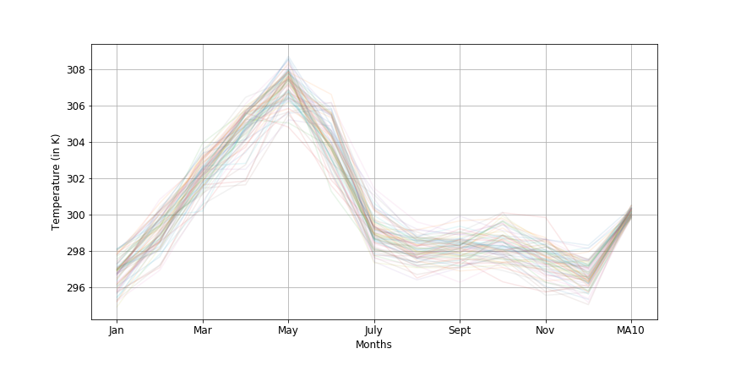
Monthly Variation:

Slide 31
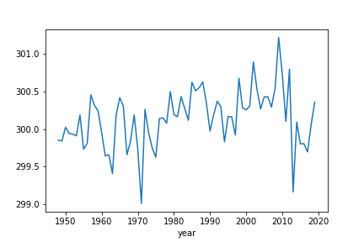
Yearly Mean of Surface Temperature:

Slide 32
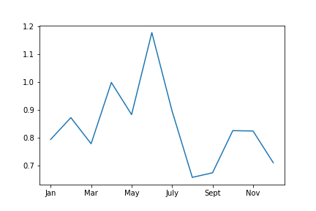
Monthly Standard Deviation:

Slide 33
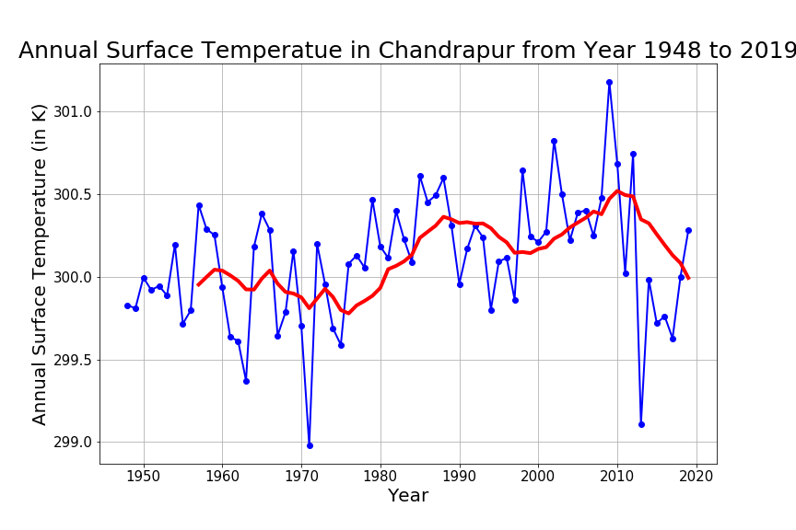
Annual Surface Temperature and Rolling Mean:

Slide 34
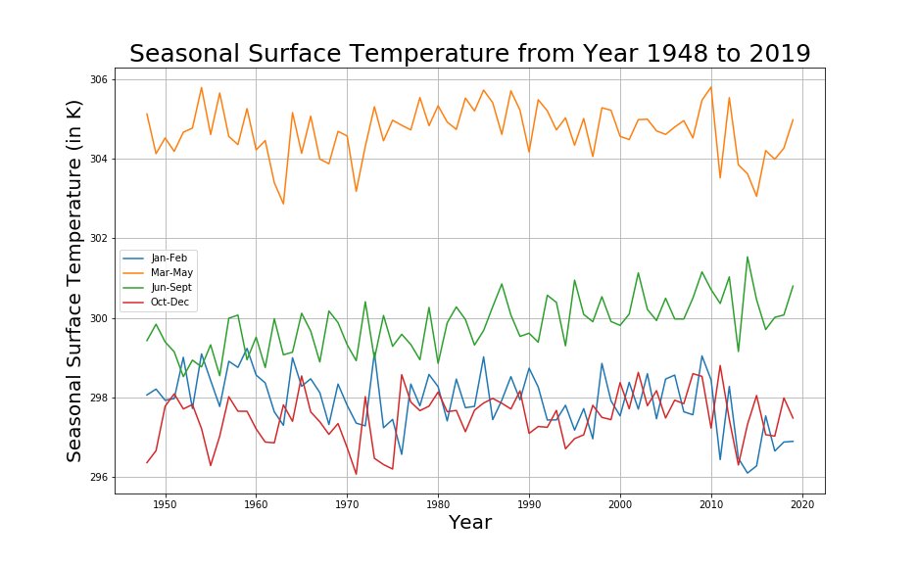
Seasonally Varying Surface Temperature:

